Slide 1
Mathematics Applications Unit 3
Chapter 1 Bivariate Data

Slide 2
Contents
Glossary or Formula Page
Page
Date
Description

Slide 3
Tasks
24
7
30
Essential Question
Questions
Notes
Summary

Slide 4
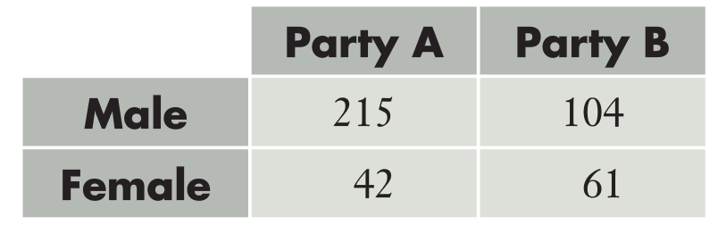
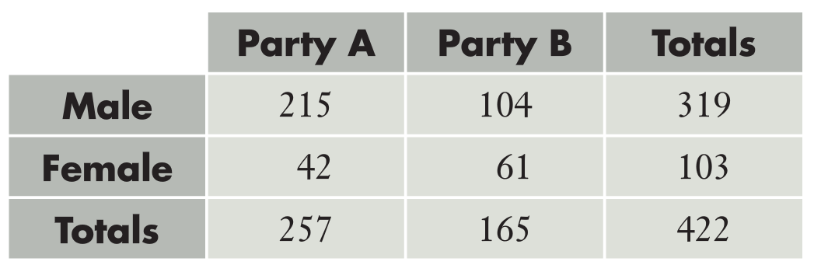
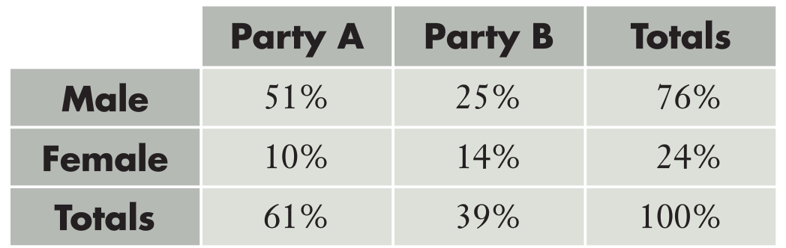
24
7
30
Date
Bivariate Data
EQ – How can I display bivariate data?
Two Way Tables
Like Venn Diagrams (from year 10), two-way tables are a visual way of representing information. The below two-way table displays information about members of two political parties and their gender
On its own, we can only draw simple conclusions. We are going to explore how more nuanced displays will allow us to see if there is an association between the two variables
Adding totals allows us to see that Party A and B have more male MPs, and that Party A has more male MPs than Party B
Converting into proportions or percentages allows for more nuance. Now we can see:
51% of all the MPs from the two parties are males from party A
76% of all the MPs from these two parties are male

Slide 5
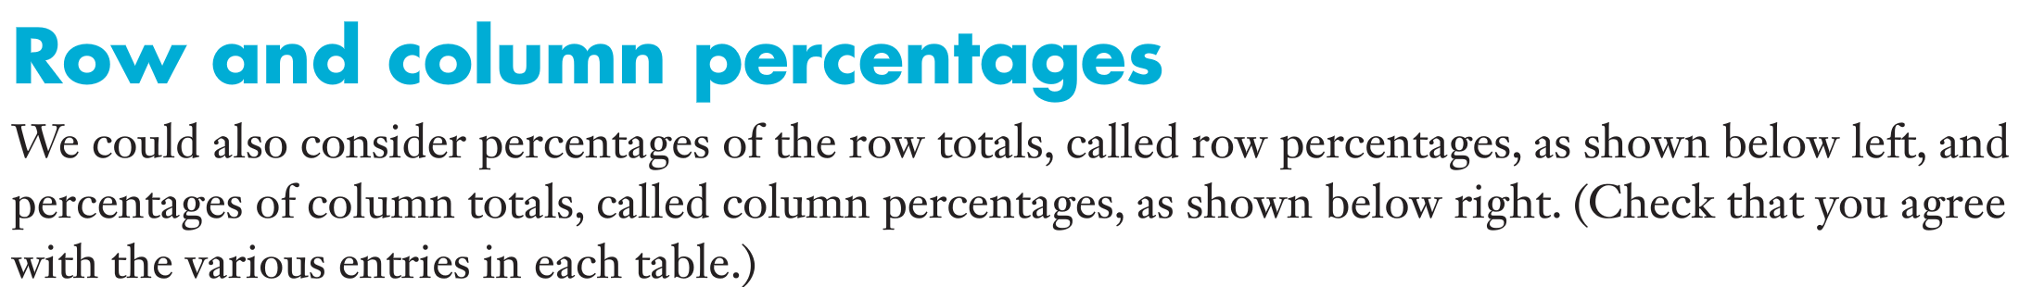
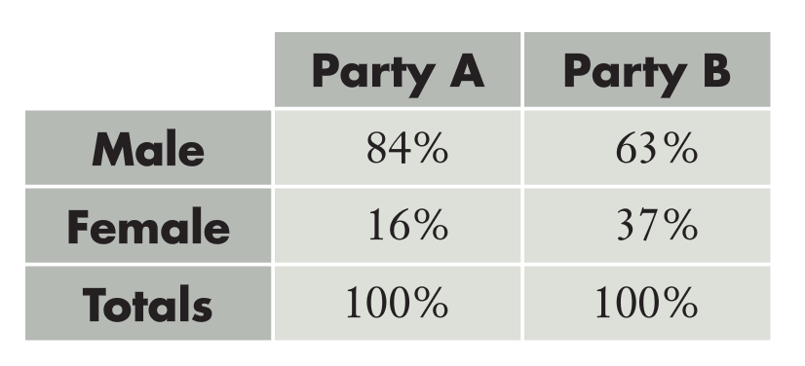
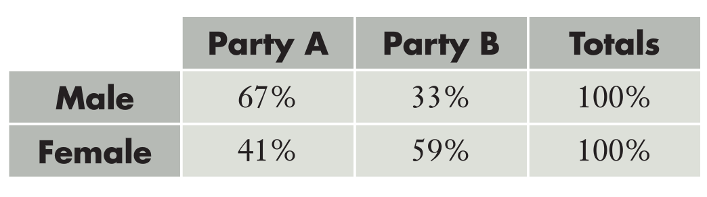
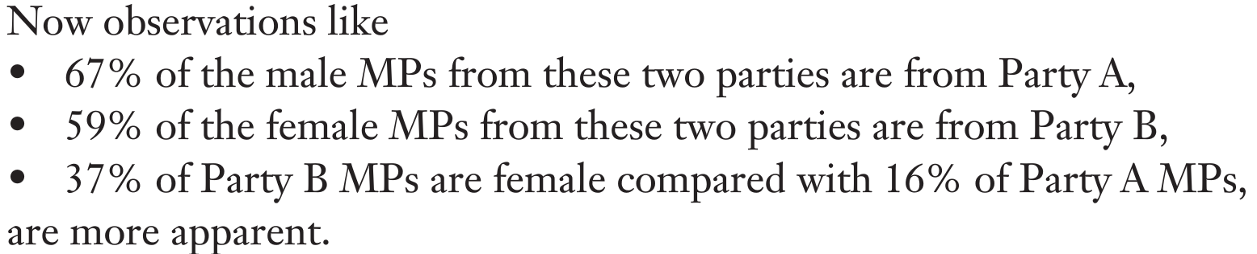
24
7
30
Date
Bivariate Data
EQ – How can I display bivariate data?

Slide 6
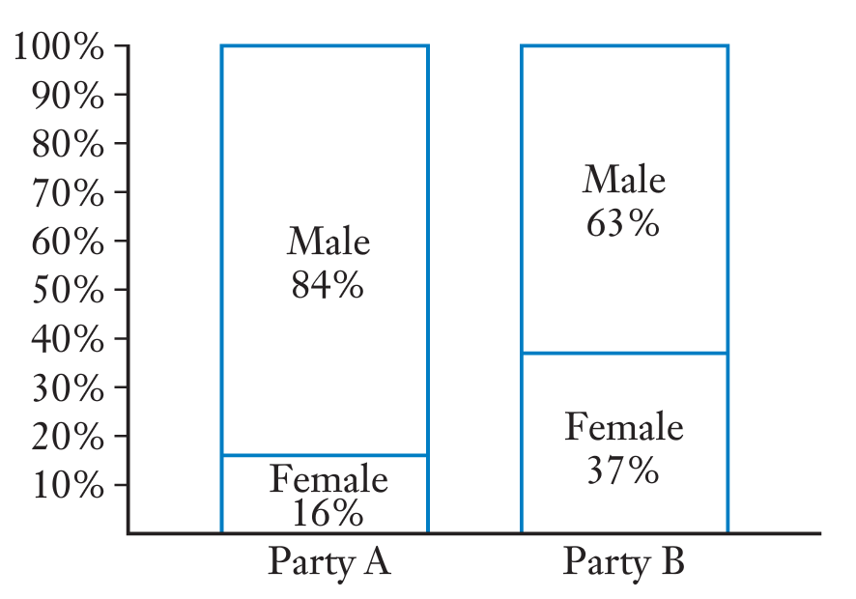
24
7
30
Date
Bivariate Data
EQ – How can I display bivariate data?
Finally, we can turn our two-way table into a proportional column graph (also referred to as a stacked 100% column graph)
Using these techniques, we can make deeper observations at every stage of the investigative process. From this proportional column graph we can say yes there is an association between these two variables

Slide 7
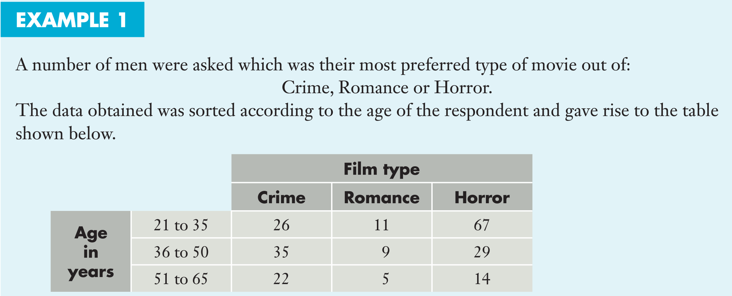
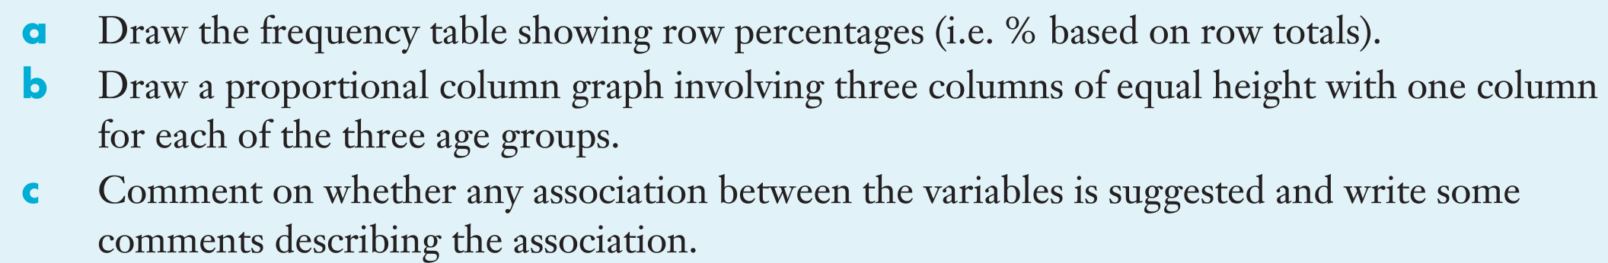
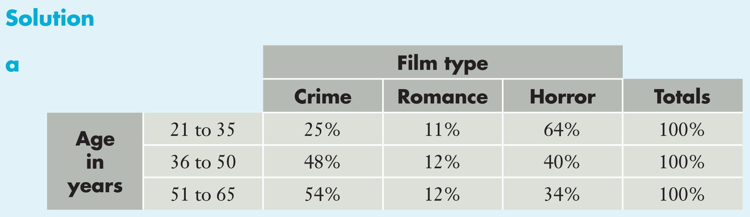
24
7
30
Date
Bivariate Data
EQ – How can I display bivariate data?

Slide 8
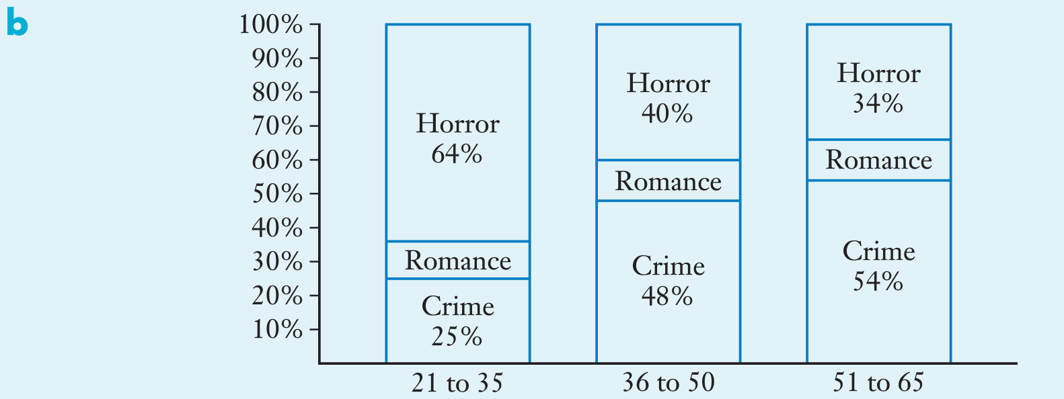
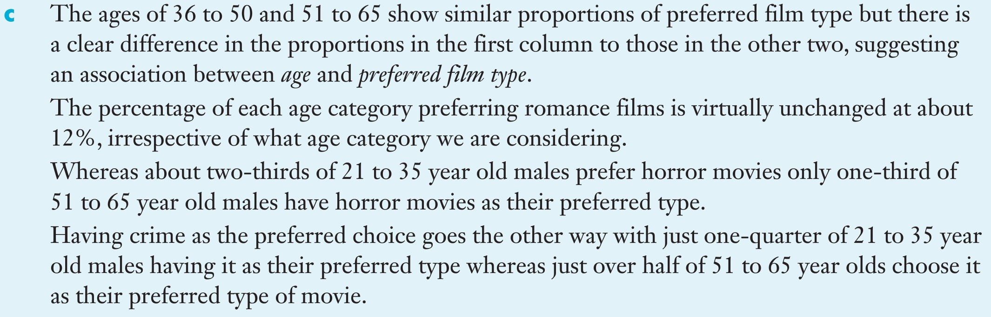
24
7
30
Date
Bivariate Data
EQ – How can I display bivariate data?

Slide 9
24
7
30
Date
Bivariate Data
EQ – How can I display bivariate data?
Please complete Sadler Unit 3 Exercise 1A

Slide 10
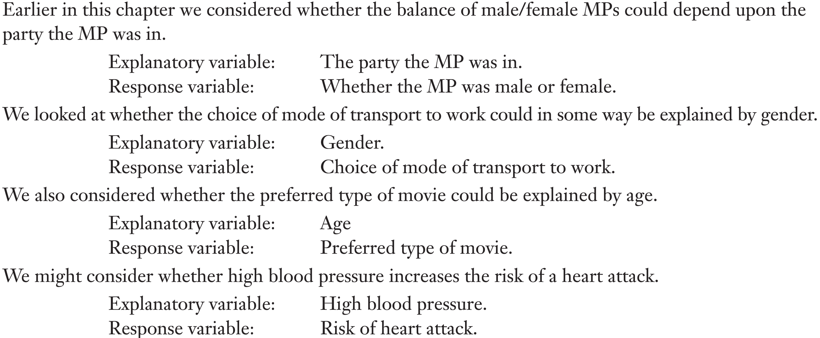
24
7
30
Date
Bivariate Data
EQ – How do I determine which variable is the explanatory and which is the response?
At the beginning of this chapter, there was a situation that considered whether countries with higher levels of consumption of a particular food tended to have higher death rates due to heart disease. I.e. – are the death rates explained by the consumption of the particular food?
In this case, we would say the consumption of the particular food is the explanatory (or independent) variable and the death rate is the response (or dependent) variable.

Slide 11
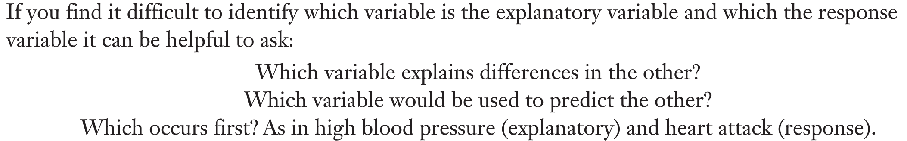
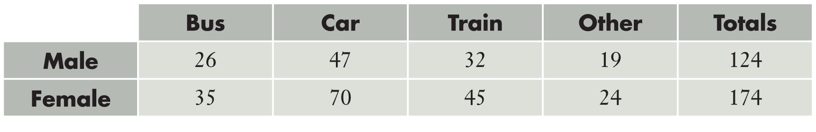
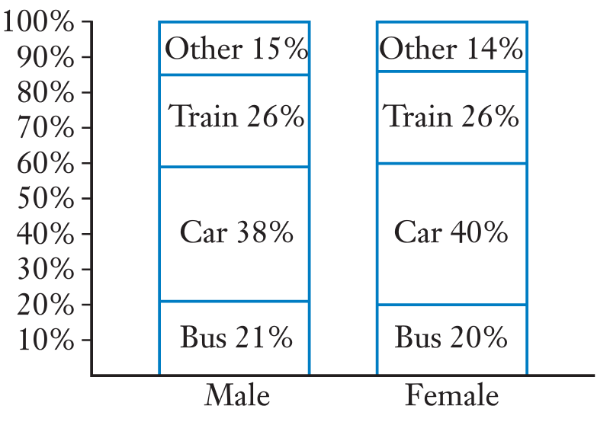
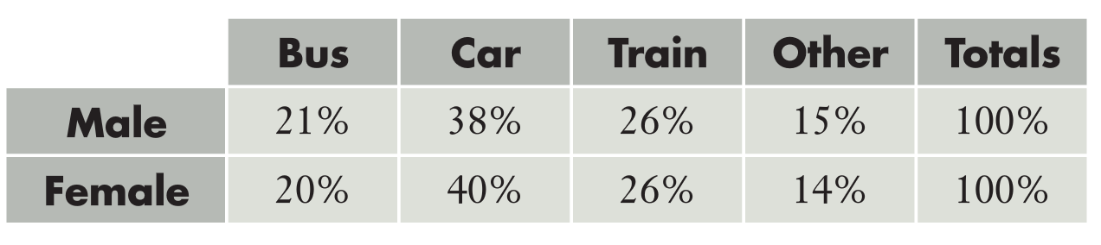
24
7
30
Date
Bivariate Data
EQ – How do I determine which variable is the explanatory and which is the response?
Which to use – row percentages or column percentages?
Let’s look at an example seeking to answer if there is an association between gender and modes of transportation to work

Slide 12
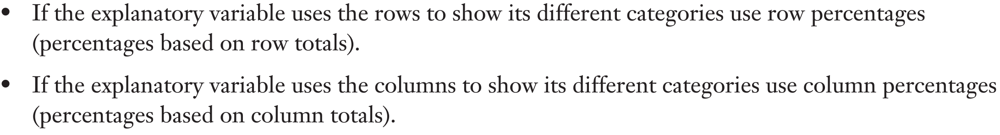
24
7
30
Date
Bivariate Data
EQ – How do I determine which variable is the explanatory and which is the response?
In this case, gender is the explanatory variable and mode of transport is the response variable (we are wondering if gender will explain mode of transport) and gender uses rows, we therefore use row percentages for our tables
Deciding whether to use row percentages or column percentages depends on the explanatory variable.

Slide 13
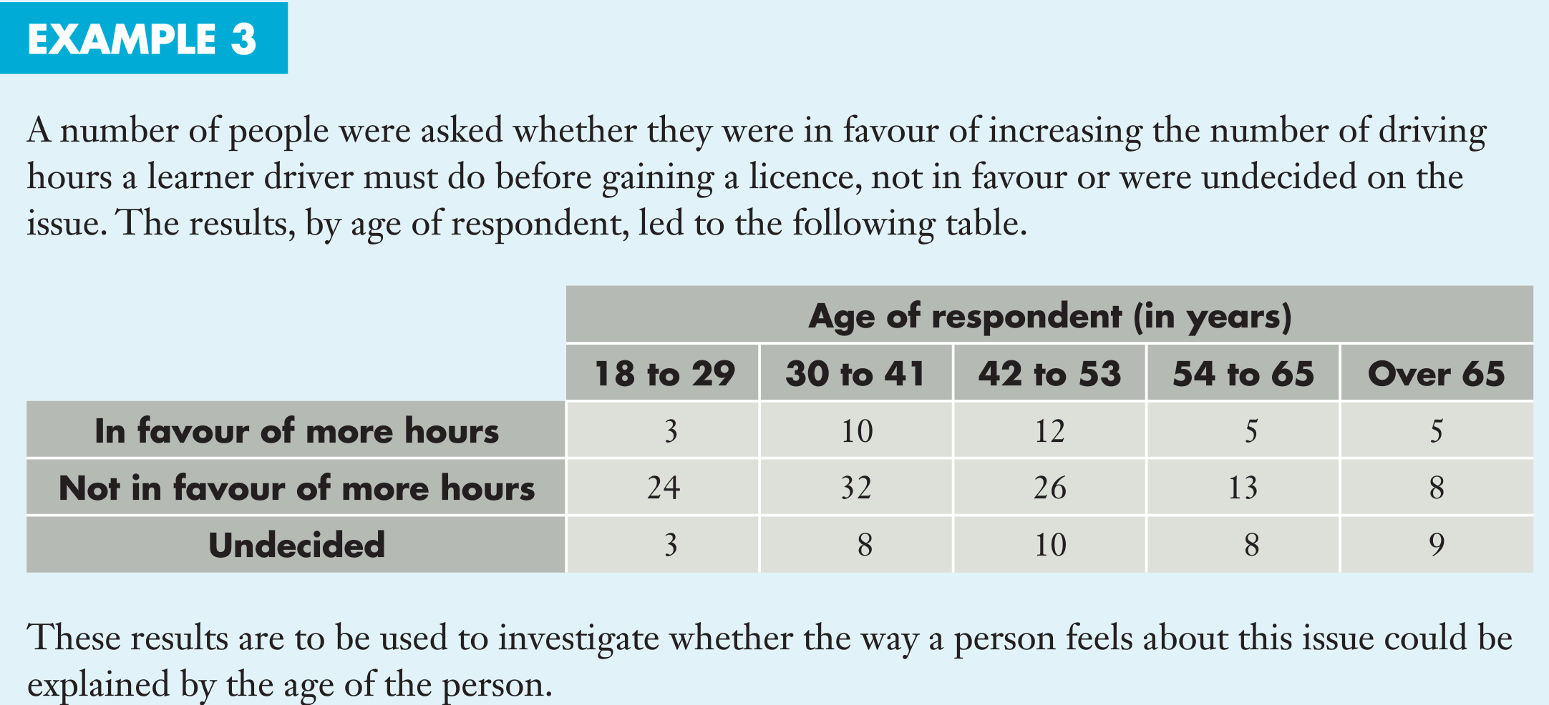
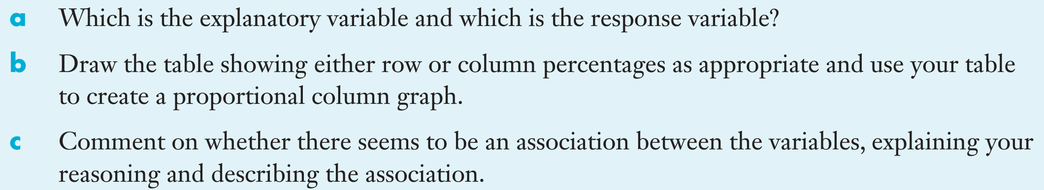

Slide 14
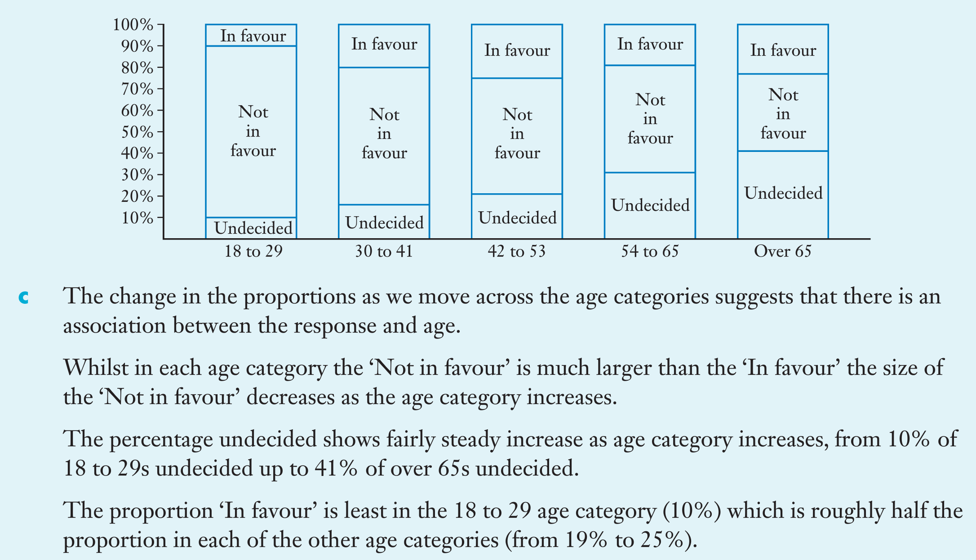
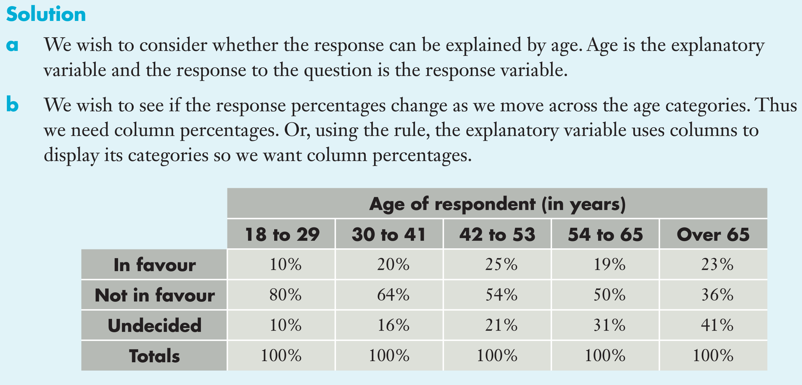

Slide 15
24
7
30
Date
Bivariate Data
EQ – How do I determine which variable is the explanatory and which is the response?
Please complete Sadler Unit 3 Exercise 1B

Slide 16
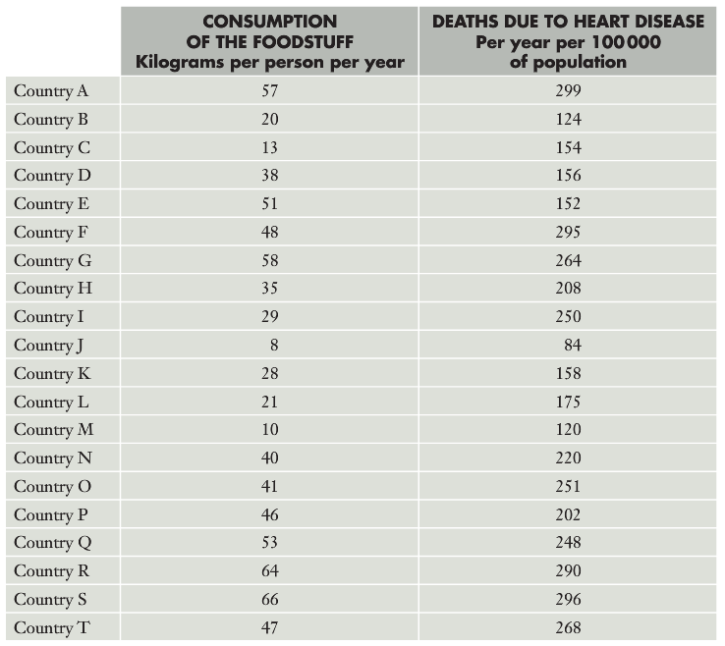
24
7
30
Date
Bivariate Data
EQ – How can I display numerical data more suitably?
Let’s revisit our original case comparing consumption of a particular food and rates of death due to heart disease

Slide 17
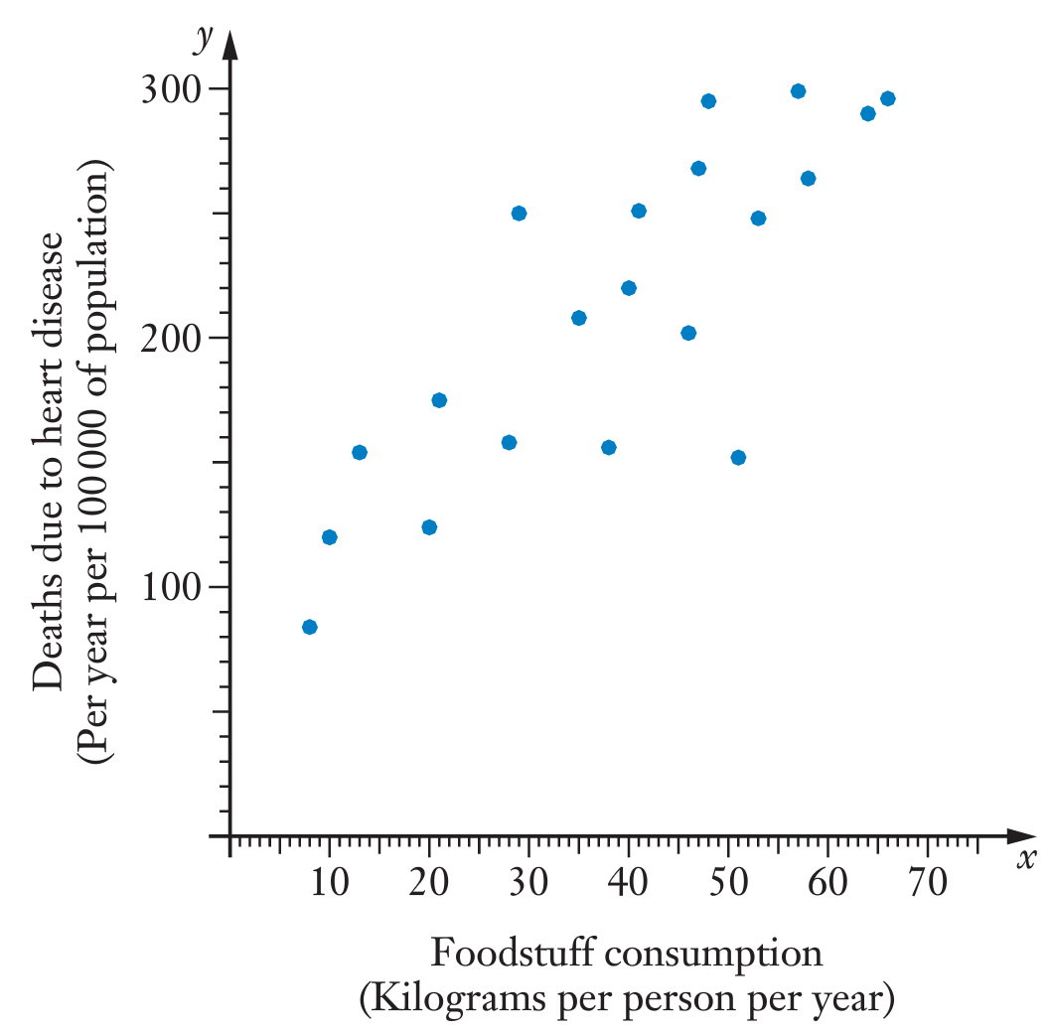
24
7
30
Date
Bivariate Data
EQ – How can I display numerical data more suitably?
Because both of these variables involve numerical data, as opposed to categorical data that other questions we’ve looked have had, a scattergraph, with one variable on the x-axis and one on the y-axis, is a more suitable form of display.
Notice that the points tend to form an oval shape, from lower left to upper right
This indicates that in general, countries with a lower consumption of a particular food have lower deaths due to heart disease.
We can say that there seems to be and association or correlation between the foodstuff consumption and the death rate due to heart disease.
Using proper mathematical language, we can attempt to summarise and underlying pattern or trend suggested by the points. Not every point will fit the trend, but we can comment on the general behavior.

Slide 18
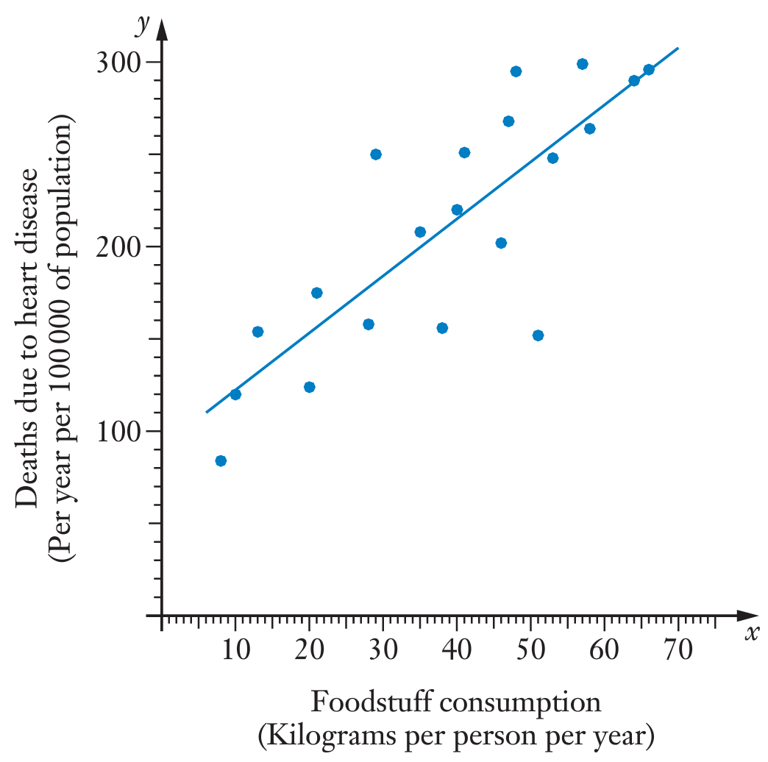
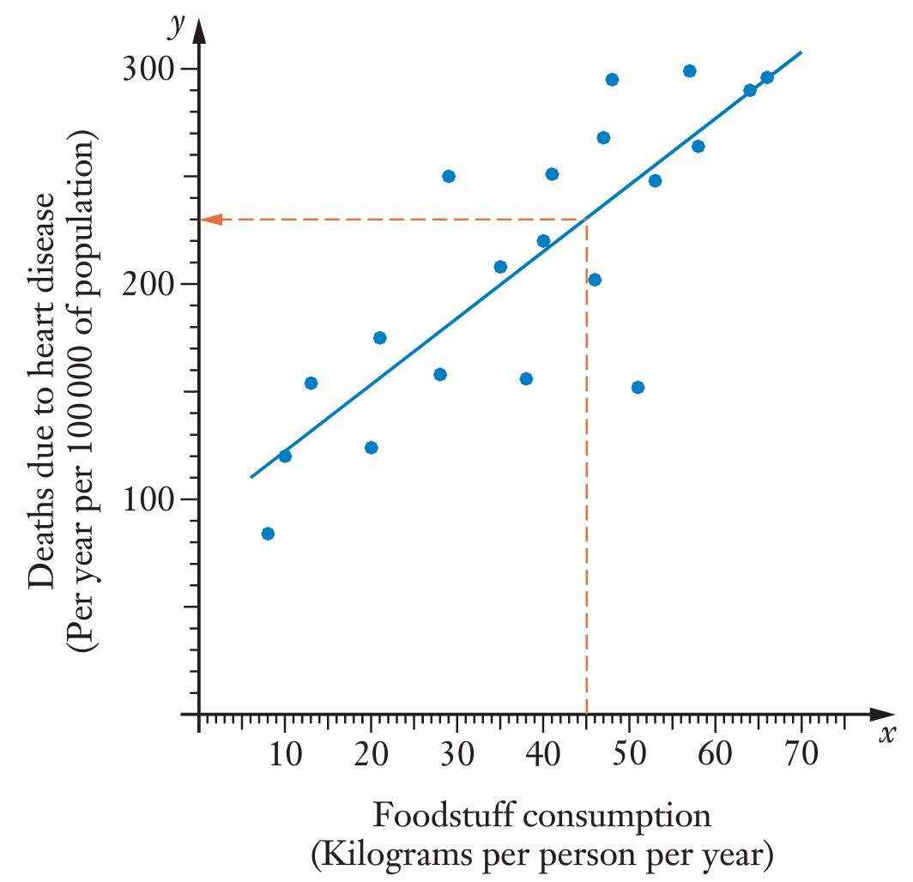
24
7
30
Date
Bivariate Data
EQ – How can I display numerical data more suitably?
Additionally, we could attempt to draw a straight line that seems to ‘best fit’ this data
In this way we could fit a linear model to the situation.
We can then use the model to make predictions.
For example, using our line of best fit, we could suggest that a country with an intake of 45kgs per person/yr of the particular food might have a heart disease death rate of approx. 230 persons per year per 100,000
Note: We tend to plot the explanatory (independent) variable on the horizontal axis and response (dependent) variable on the vertical axis

Slide 19
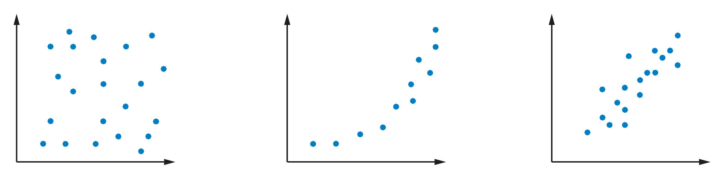
24
7
30
Date
Bivariate Data
EQ – How can I display numerical data more suitably?
How reliable are our predictions? Some things we need to consider are:
Does the distribution of points on the scattergraph suggest that using a linear model is a good idea, or should we perhaps use another model (which we’ll learn later)? Consider the following:
One of these graphs suggest using a linear model is appropriate, another suggest using a curve, while another shows no particular pattern.
How many points does the scattergraph involve. The more we have, the more confidence we have in our predictions.
How closely do the points fit a straight line? The closer the points are to a straight line, the better the linear model will be and the more confidence we can have in our predictions.

Slide 20
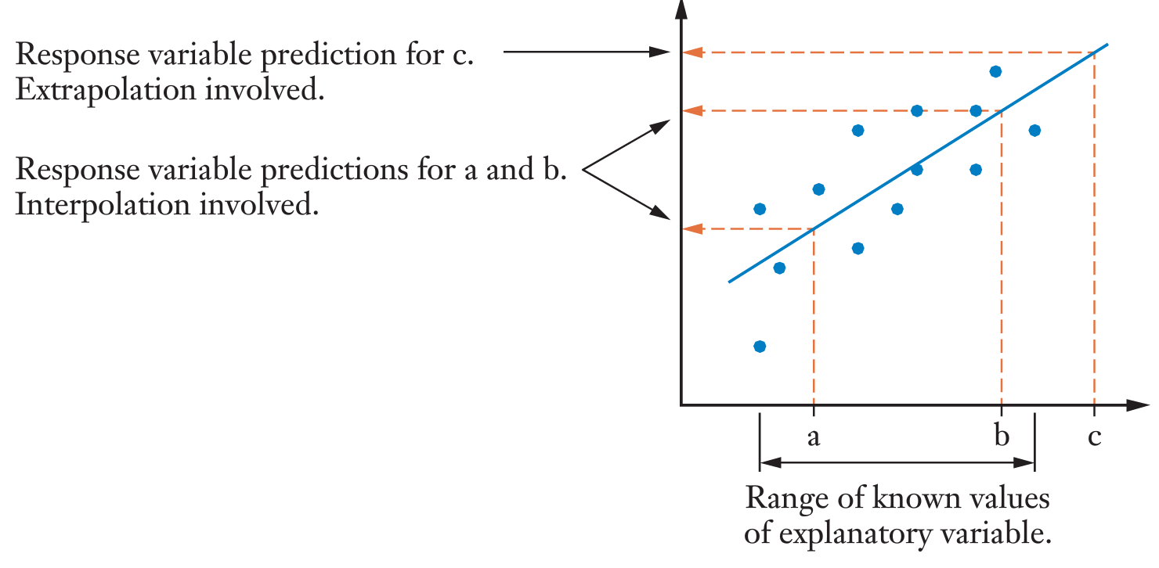
24
7
30
Date
Bivariate Data
EQ – How can I display numerical data more suitably?
Finally, we need to consider: Are we making a prediction for a value that lies within or without the spread of our known values? I.e – does our prediction involve interpolation (between the given points) or extrapolation (beyond the given points)? Predictions involving extrapolation are likely to be less reliable.

Slide 21
24
7
30
Date
Bivariate Data
EQ – How can I display numerical data more suitably?
Let’s apply all of this to our earlier prediction that a country with a consumption of 45kg of a particular foodstuff will have a death rate due to heart disease of approx. 230 deaths per year per 100,000 people:
We can be reasonably confident in this prediction because:
The graph does suggest a linear model could be appropriate
The graph involves a reasonable number of data points
The figure of 45kg/person per year is within the values covered by the given data, therefore interpolation is involved

Slide 22
24
7
30
Date
Bivariate Data
EQ – How can I display numerical data more suitably?
Please complete Sadler Unit 3 Exercise 1C (odd numbers only) in class and Miscellaneous Exercise 1 for homework

Slide 23
Notes Review
24, 7 ,30
Date
Title
Essential question
Notes complete
Notes complete with colour and diagrams
Questions completed
Contents page filled in
Formula page filled in

Slide 24
Homework
Review your notes and write a summary answering the essential question.

